Slide 1
10. Courts
Breakout Sessions
POLS 1101
12:40pm-1:30pm Park Hall 145
& 1:50pm-2:40pm Leconte Hall 135
SIYUAN (Siri) ZHAO
Siri.Zhao@uga.edu
Notes:
Today we re going to talk about

Slide 2
Supreme Revenge: Battle for the Court (2019)
How has the U.S. Supreme Court become a central battlefield in American partisan politics?
  Since Supreme Court justices serve for life, appointments by a certain president can have further impacts beyond his office, shaping the future of American law and society.
The failed nomination of Robert Bork (Conservative) in 1987
Decades in escalating political conflict over judicial appointments
Senate Majority Leader Mitch McConnell’s strategy to block President Obama’s nominee, Merrick Garland (Liberal), and to later secure seats for President Trump’s appointees

Slide 3
Key Figures (thanks to ChatGPT!)
Name | Role/Position | Involvement in the Court Battle
Mitch McConnell | Senate Majority Leader (Republican, Kentucky) | Blocked Merrick Garland’s nomination in 2016; later pushed through Trump’s nominees. Central figure of the “revenge” narrative.
Chuck Grassley | Chairman, Senate Judiciary Committee (Republican, Iowa) | Refused to hold hearings for Garland’s nomination in 2016, supporting McConnell’s strategy.
Robert Bork | Supreme Court nominee (1987, by President Reagan) | Defeated in Senate confirmation, marking the start of highly politicized judicial battles.
Clarence Thomas | Supreme Court Justice (nominated by President George H.W. Bush, 1991) | Confirmation hearings dominated by sexual harassment allegations; symbol of divisive confirmations.
Merrick Garland | Supreme Court nominee (2016, by President Obama) | Blocked from even receiving a hearing; later became U.S. Attorney General under President Biden.
Brett Kavanaugh | Supreme Court Justice (nominated by Trump, 2018) | Took the seat that would have gone to Garland. Faced a highly contentious confirmation with allegations of sexual misconduct.
Ruth Bader Ginsburg (RBG) | Supreme Court Justice (appointed by President Clinton, 1993) | Iconic liberal justice; her 2020 death opened the door for the third major rightward shifts in the Court since 1953.

Slide 4
Potential Questions for Reflection
Do you think the Supreme Court can still be considered an independent, nonpartisan institution? Why or why not?
Should the Senate have such strong power to block or push through judicial nominations (leading to partisanship)?
Should Supreme Court justices still serve for life, or should there be term limits (given their really big influence)?
Was Mitch McConnell’s blocking of Merrick Garland in 2016 justified, or was it purely partisan revenge?
How does the politicization of the Court affect public trust in American democracy?
If you were a policymaker, what reforms (if any) would you propose for the Supreme Court?
Notes:
Remember it’s still some kind of media presentation.
So… we need to tell facts from ideas.
However, the media itself comprises of a “higher-order” fact – so it can also shape people’s view toward political polarization / partisanship.
We should be careful about it!

Slide 5
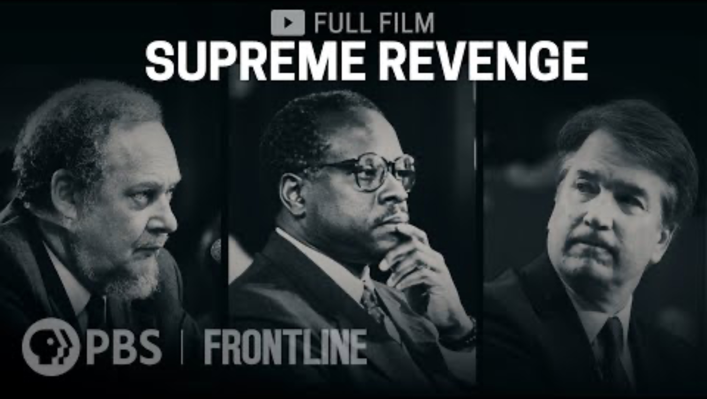

Slide 6
Next week…
Read materials on Political Parties & Interest Groups before class, and that will be helpful to participate in peer discussions.
Feel free to email me if you have any questions!
ENJOY YOUR WEEKEND!

